Slide 1

Md. Zobaidul Islam Jabed
ID: R222212
Program: RMBA
Major Finance and Banking
Department of Business Administration
Faculty of Business Studies
INTERNATIONAL ISLAMIC UNIVERSITY CHITTAGONG

Slide 2
Types of Cyber Attack in Global Financial sectors and its threats to Financial System with Solution

Slide 3
Table of Contents
1
Introduction
2
Objectives of the study
3
Methodology and Model
Dataset
4
Findings
5
6
Recommendation
7
Conclusion

Slide 4
Introduction
Cyber Attack
Cyber Attack on Financial Sectors

Slide 5


Introduction
Types of Cyber-crime in financial sectors
Password Login Attack
DDoS Attack
Spam Email
DNS Attack
Phising Attacks
Web Attack

Slide 6
Objectives of the study
1
To know about the types of Cybercrimes on Banking and Financial sectors
To analyze what are the impacts of Cybercrimes on banking and financial sector
2
To forecast the financial losses for upcoming years that will give some intuition to many financial organization like World Bank, IMF so that these organization can take necessary policy or strategy to overcome cyber hazard
3
4
To suggest a model to mitigate the cyber risk
5
To suggest some recommendations according to findings

Slide 7
Methdology and Model
DATA COLLECTION: In order to make the study more meaningful and presentable it will be based on secondary data. For this research Quantities data undertaken from
Article of Raymond Pompon named ‘Cyber attack on Financial institutions’
Annual report of FBI’s Internet Crime Complain Center(IC3) about Financial Losses due to cyber crime.
DATA ANALYSIS: To forecast financial losses I did Time Series Analysis in the dataset of annual report of FBI’s. To do Time series analysis I used Least Squared Method to get trend line equation and forecast financial losses for next Five years. Lastly I have shown correlation between top two cyber attack which are mostly effecting financial sectors.

Slide 8
Graphical Presentation

Slide 9
Graphical Presentation

Slide 10
Graphical Presentation

Slide 11
Graphical Presentation

Slide 12
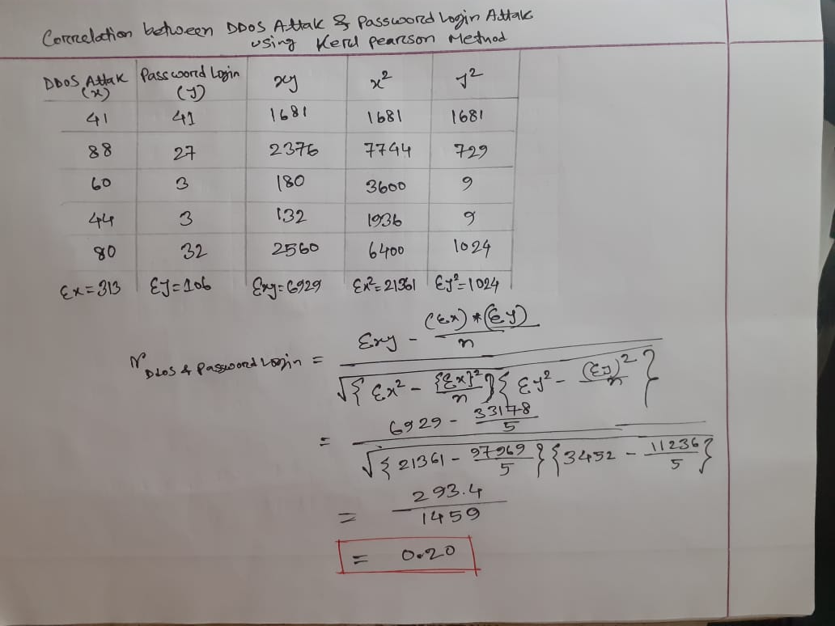
Correlation Between Top Two Cyber Attack (using kerl pearson method)
Correlation r_{Ddos & Password Login}= 0.20

Slide 13
Dataset
Year | Complaints | Financial Losses(Billion)
2019 | 467361 | $3.5
2020 | 791790 | $4.2
2021 | 847376 | $6.9
2022 | 800944 | $10.3
2023 | 880418 | $12.5
FBI’s Internet Crime Complain Center(IC3) Annual Report

Slide 14
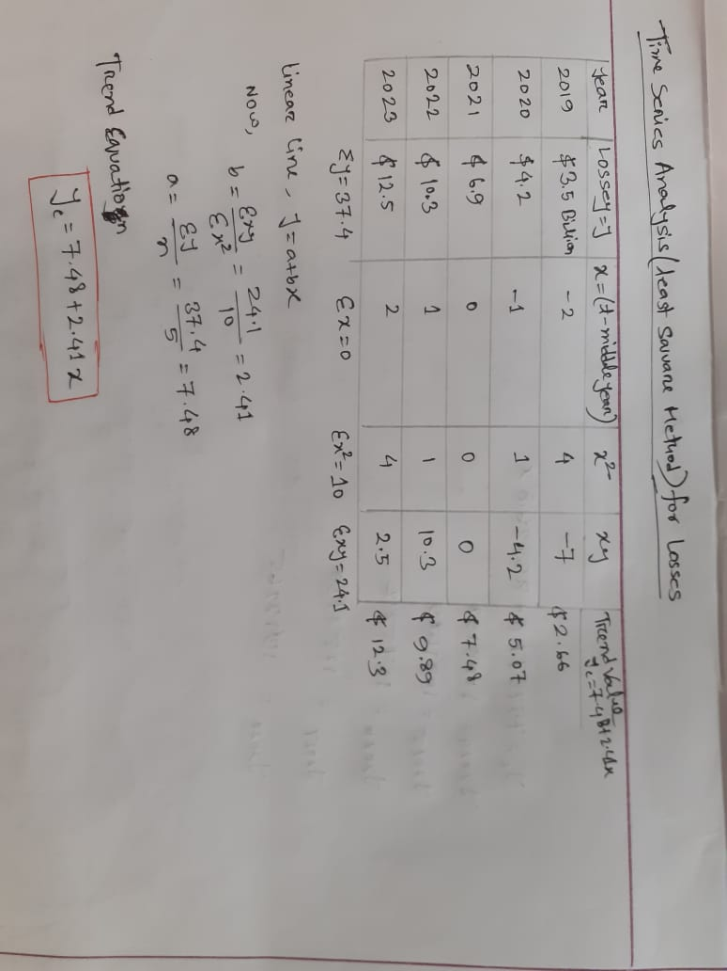
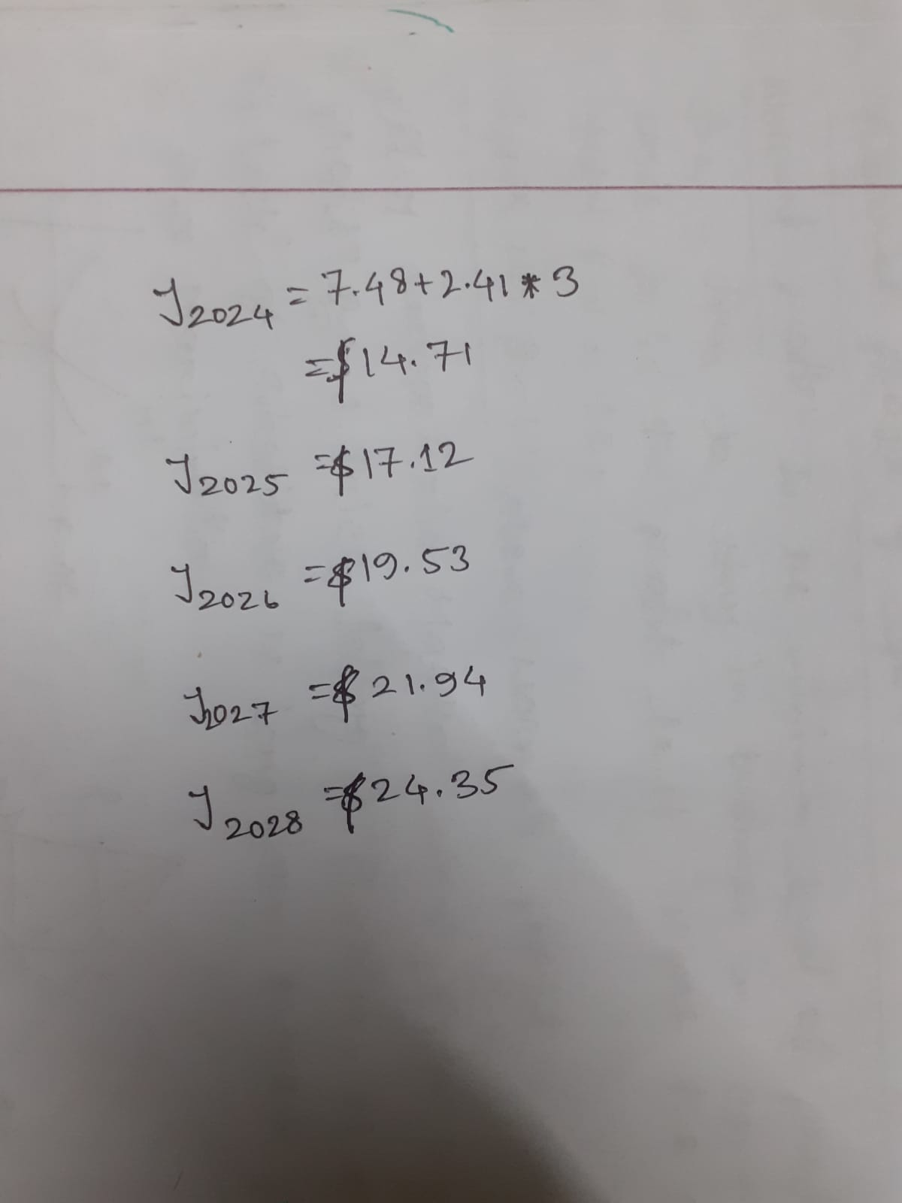
Time series analysis for Losses (using Least Square method)

Slide 15
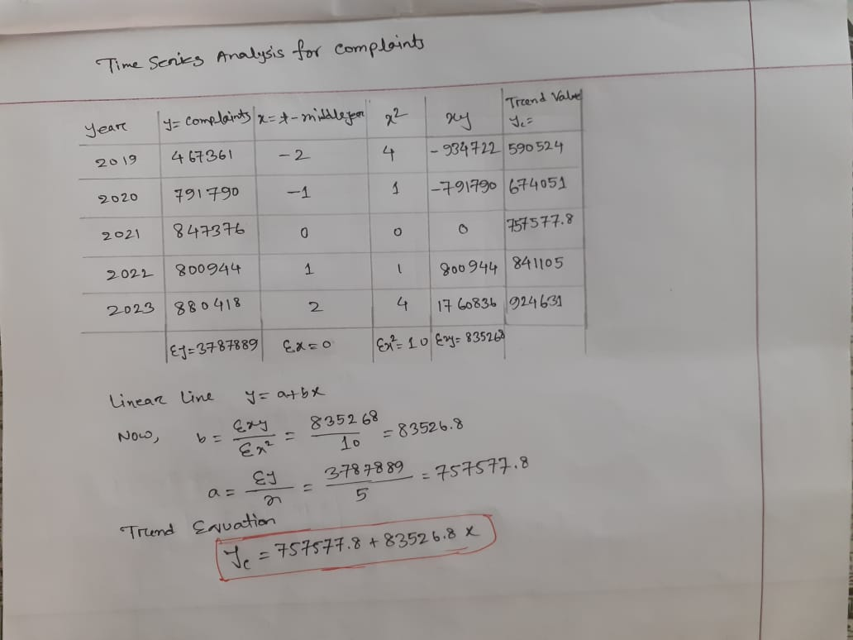
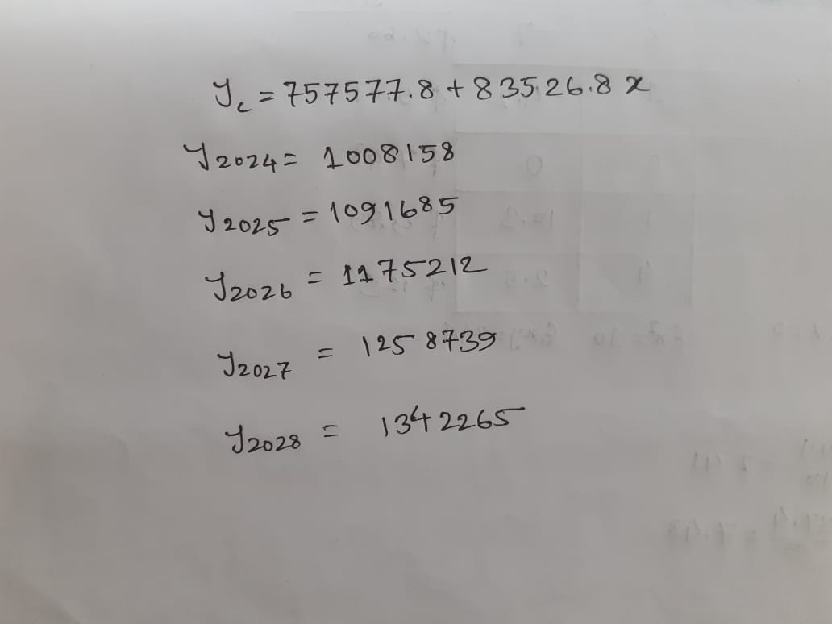
Time series analysis for Complaints (using Least Square method)

Slide 16
Result Analysis
Trend Equation | R square | Mean | Standard Deviation | Standard Error
Y_{c} = 7.48+2.41x | 0.96 | 7.48 | 3.87 | 1.73
Table : Trend equation, R square, Mean, Standard Deviation, Standard Error for observed Losses of (2019-2023)
Year | Losses(Billion) | Trend Equation Value(y = a+bx)
2019 | $3.5 | $2.66
2020 | $4.2 | $5.07
2021 | $6.9 | $7.48
2022 | $10.3 | $9.89
2023 | $12.5 | $12.3
Table : Trend equation value

Slide 17
Result Analysis
Year | Forecasted complains (Next five years) | Forecasted Financial Losses (Next Five years)
2024 | 1008158 | $14.71
2025 | 1091685 | $17.12
2026 | 1175212 | $19.53
2027 | 1258739 | $21.94
2028 | 1342265 | $24.35
Table : Forecasting complaints and Losses(2024-2028)

Slide 18
Result Analysis of Forecasted losses
Trend Equation | R square | Mean | Standard Deviation | Standard Error
Y_{c} = 12.3+2.41x | 1 | 19.53 | 3.81 | 1.70

Slide 19

Findings
Form report of FBI’s Internet Crime Complain Center (IC3) annual report financial losses against complaints is shown. From this report total 3.79 Million Complaints wear occurred from there $37.4 Billion Losses happened. And also if the graph is being seen that the losses is gradually touching the top of the head. If I find the trend equation for this then it will be Y_{c} = 7.48+2.41x where a = 7.48 and b = 2.41 and also value of r²is 0.96. Mean is 7.48, Standard Deviation 3.87 and Standard Error is 1.73.
In Figure 4.9 I have forecasted complaints and losses for next five years(2024-2028). For which I found Trend equation of Y_{c} = 12.3+2.41x and the value of r² is 1 that means data is well fitted. For which mean is 19.53, standard deviation is 3.81, standard error is 1.70 So special focus should be given for upcoming future. Also using the trend equation of complaints Y_{c} = 757577.8+83526.8x I calculated future complaints for next five years(2024-2028).
Correlation between DdoS and Password Login or Sql Attack is 0.20 which is positive but not strong positive. That means the rise of Ddos Attack also increase the opportunity that there is also a chance of being Password Login Attack at that particular financial sector.

Slide 20
Recommendation
Implement Strong Security Measures: Require MFA for accessing sensitive systems and data to add an extra layer of security beyond just passwords. Use encryption for data at rest and in transit to protect sensitive information from unauthorized access. Deploy advanced firewalls and IDS to monitor and block suspicious activities and potential intrusions.
Ensure that all software, hardware, and firmware are regularly updated and patched to
protect against known vulnerabilities. Implement a robust patch management process. Provide ongoing cybersecurity training for employees to recognize and respond to phishing attempts, social engineering attacks, and other common threats. Create a culture of security awareness within the organization.
Perform regular security audits and penetration testing to identify and address vulnerabilities in the network and systems. This helps to proactively detect and fix security weaknesses.
Join industry groups such as the Financial Services Information Sharing and Analysis Center (FS-ISAC) to share threat intelligence and best practices with other financial institutions. Collaboration enhances collective cybersecurity defense capabilities.
In 4.10 pera I calculated correlation between Password Login Attack and DdoS attack which is 0.20 so that policy maker can have an intuition that if any particular financial sector has a threat of Password Login Attack then there is also a high chance of being attacked by DdoS attack.

Slide 21

Conclusion
In conclusion, enhancing financial security in the face of evolving cyber threats requires a proactive, multi-faceted approach. Financial institutions must implement robust security measures, regularly update and patch systems, and conduct frequent security audits and penetration testing. Employee training and awareness are crucial in recognizing and mitigating phishing and social engineering attacks.

Slide 22

THANK YOU!
Any questions?

